Slide 1
Ratios
Rates and Unit Rates

Slide 2
Standard(s)
MGSE7.RP.1 Compute unit rates associated with ratios of fractions, including ratios of lengths, areas and other quantities measured in like or different units.

Slide 3
I Can Statement(s)
I can compute unit rates of two quantities measured in like or different units.

Slide 4
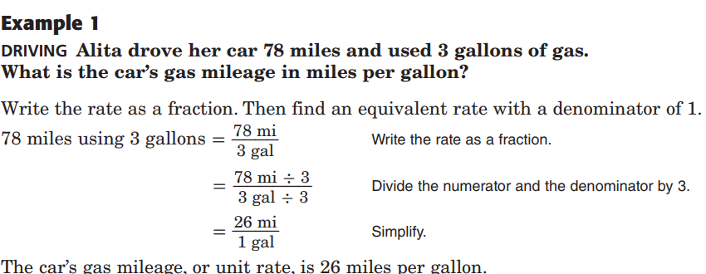

Slide 6
X = 6 people
X = $52
$$\frac{People}{\# of vans}$$
$$\frac{cost (\$)}{\# of books}$$
= $\frac{\$156}{3 books}$
= $\frac{x dollars}{1 book}$
= $\frac{18 people}{3 vans}$
= $\frac{x people}{1 van}$
X = 57.5 miles
X = 0.37 game
$$\frac{Distance (miles)}{Time (hours)}$$
= $\frac{115 miles}{2 hours}$
= $\frac{x miles}{1 hour}$
$$\frac{hits}{games}$$
= $\frac{8 hits}{22 games}$
= $\frac{x hits}{1 game}$

Slide 7
X = 24.07 miles per gal
$\frac{miles}{gallon}$
$\frac{calories}{time (hours)}$
=$\frac{2500 calories}{24 hrs}$
=$\frac{x calories}{1 hr}$
= $\frac{65 miles}{2.7 gallons}$
= $\frac{x miles}{1 gallon}$
X = 104.17 calories per hour
= $4.32 per 1b
= $\frac{21.95}{5 lbs}$
= $4.39 per 1b
= $\frac{12.95}{3 lbs}$
= $\frac{\$2.50}{32 oz}$
= $0.08 per oz
= $\frac{\$3.84}{48 oz}$
= $0.08 per oz

